Slide 1

P
Pathwaay
CAREER EXPLORER
DOMAIN 1 · AIVERSECITY WORKFORCE
● AI-POWERED CAREER & SDG NAVIGATION
A clear starting point for what comes next.
Evidence-backed skill forecasting, explainable future-role matching, and SDG-aligned reskilling pathways for tomorrow's talent.
TEAM 3AM · github.com/weiiilunnnn/3am-sdc-hackathon
MAIN SDG 4 · RELEVANT SDGS 5, 8, 9, 10

Slide 2

01 · THE WORKFORCE GAP
AI Outpaces Static Training Frameworks
56%
26%
600K+
Use AI Tools Daily
Formally Trained
Workers Need Reskilling
Malaysian professionals active on AI.
Hays Asia Salary Guide 2025 benchmark.
MOSTI 3-to-5 year national projection.
Obsolete Static Lists
Blind Skill Selection
Invisible SDG Impact
Course catalogs lag behind real job signals.
Graduates guess which AI competencies matter.
Career choices lack sustainability visibility.

Slide 3

02 · TARGET USERS & PERSONA
Built for People Navigating Career Inflection Points
● DEMO PERSONA SPOTLIGHT
Fresh Graduates & Switchers
Alan Tan
Translating academic projects into verified market skills.
Information Systems · Aiversecity Demo University
Working Adults at Risk
Pivoting away from automating routine tasks early.
Builds clear data summaries and seeks evidence-based career directions supporting sustainable team decisions.
HR & L&D Managers
Mapping team skill gaps to HRD Corp programmes.
TVET & University Centres
GOAL: Data-informed sustainability roles
Advising students with live labour-market evidence.

Slide 4


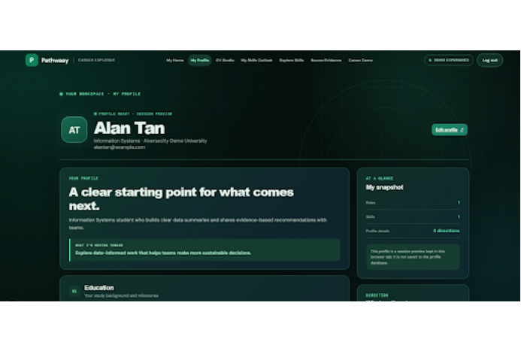
03 · MEET PATHWAAY
Live Workspace From Profile Intake to Role Match
MODULE 01
My Profile & CV Studio
Session-safe skill extraction without storing private PII.
MODULE 02
My Skills Outlook
Rising vs declining role radar under AI scenarios.
MODULE 03
Source Evidence Engine
Every recommendation cites dated public trend signals.

Slide 5
04 · USER WORKFLOW
From Current Skills to AI-Era Career Pathways
01
02
03
04
Profile Intake
Skills Radar
Role Matching
SDG Pathway
Parse skills via CV Studio or guided intake.
Track emerging and declining market signals.
Rank best-fit roles with transparent gap scores.
Follow time-boxed courses linked to UN SDGs.

Slide 6
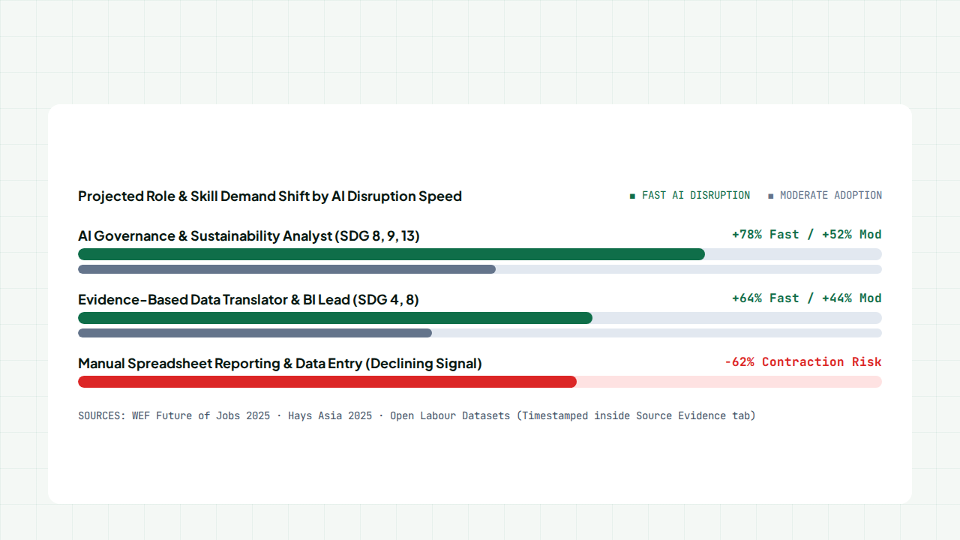
05 · DYNAMIC SIGNAL LAYER & UNCERTAINTY
Scenario-Based Skill Demand Forecast (2025–2030)

Slide 7
06 · PROBLEM-SOLUTION FIT
Complete Coverage of Domain 1 Must-Have Features
MUST-HAVE FEATURE | PATHWAAY MODULE | VERIFIABLE IMPLEMENTATION
1. Skills Profile Intake | My Profile & CV Studio | Structured profile builder and CV parser
2. AI-Trend Signal Layer | Source Evidence Tab | Updatable JSON/API feeds with source dates
3. Future-Role Matching | Explore Skills & Roles | Explainable match % and skill-gap breakdown
4. Reskilling Pathway | Career Demo Planner | Time-estimated free & HRD Corp courses
5. UN SDG Mapping | Direction & Impact Tags | Every skill and role mapped to SDGs 4, 5, 8, 9, 10
6. Handling Uncertainty | My Skills Outlook | Moderate vs Fast AI disruption scenario toggles

Slide 8
07 · SUSTAINABILITY BY DESIGN
Connecting Every Career Move to the UN SDGs
SDG 4 · MAIN GOAL
SDG 8 · TARGET 8.5
SDG 9 & SDG 5 / 10
Quality Education
Decent Work
Inclusive Innovation
Accessible lifelong technical reskilling pathways.
Productive employment resilient against automation.
Bias-checked recommendations reducing workforce inequality.

Slide 9
08 · FEASIBILITY & AI GUARDRAILS
Engineering Trustworthy, Hallucination-Free Guidance
HARDEST TECHNICAL RISKS
PATHWAAY ARCHITECTURE FALLBACKS
LLM Hallucinations: Unconstrained models invent fake courses or job statistics.
Grounded Evidence Graph: Recommendations strictly cite verified catalog IDs.
Stale Trend Feeds: External job APIs can rate-limit or change schema.
Snapshot Fallback Cache: Validated local trend snapshots guarantee live demo uptime.
Privacy Exposure: Uploading personal CVs risks leaking sensitive PII.
Browser Session Sandbox: Synthetic profiles run locally in-tab without DB persistence.

Slide 10
P
PATHWAAY · LIVE PROTOTYPE READY
Empowering Human Career Decisions in the AI Era.
From profile intake to source-cited future roles and SDG reskilling pathways in minutes.
github.com/weiiilunnnn/3am-sdc-hackathon

